Slide 1

Iowa Veterans Home Non-Employee Orientation
1301 Summit Street Marshalltown, Iowa 50158 641-752-1501

Slide 2
WELCOME TO THE IOWA VETERANS HOME
This learning module provides information that will prepare you for your volunteer or contract experience.

Slide 3
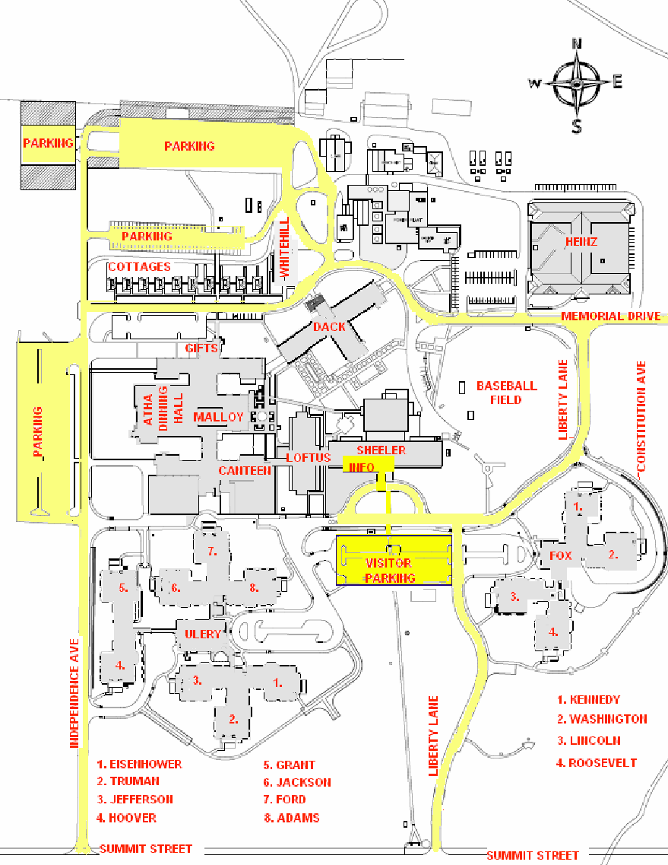
PARKING AND SECURITY
As a Volunteer or contractor, you are allowed to park in visitor parking spots.
Parking is also available in the lots located directly north of the cottages and Whitehill building.
The IVH grounds are patrolled by Security Officers during shift changes and throughout the day and night.

Slide 4
ILLNESSES AND INJURIES
Illnesses
See COVID Policies 153 and 154D.
Injuries
In the event of an injury contact a supervisor or the IVH Employee Health Nurse (Dial #4444) to assess the seriousness of the injury, to administer first aid if necessary, or to authorize emergency treatment at the UnityPoint Emergency Room in Marshalltown, if necessary.
TB testing
There may be requirements for TB testing, please discuss with your identified contact with IVH.

Slide 5
DRESS CODE
Volunteers and Contracted agencies are expected to dress in a professional manner and adhere to the dress code within their organization or what has been identified in their orientation to the facility.
All volunteers and contracted agencies are expected to exhibit and maintain a well groomed appearance.
An identification badge must be worn and remain visible at all times.
Closed-toed shoes are required in all areas.
The wearing of jewelry or decorative accessories may be limited due to the nature of a particular work assignment.
Hair must be pulled back when assisting residents with activities of daily living, volunteer work, or working within capacity of the contracted services.
Nail polish should not be chipped or cracked.
Keep natural nail tips less than 1⁄4 inch long. No artificial/acrylic nails are allowed.

Slide 6
MONEY/VALUABLES
IVH is not responsible for lost or stolen valuables. It is suggested that you bring only a modest amount of money to enable you to purchase meals/snacks.
Please leave other valuables and prescription medications at home. Purses and bags should be placed in designated areas or left in the trunk of your vehicle.
IVH accepts debit/credit cards and various electronic payment methods.

Slide 7
CELL PHONE USE
Cell phone use is not allowed in resident care areas.
If a family member must contact a volunteer or contracted agency member, he/she is in the clinical area, the call should go through the Switchboard.

Slide 8
TOBACCO PRODUCT USE
Employees/Volunteers/Students
Smoking and the use of tobacco is authorized within the confines of privately-owned motor vehicles that are located on IVH property.
Residents
Smoking IS permitted in designated areas only with supervision and oxygen being stored in appropriate locations.

Slide 9
RESIDENT CARE RESPONSIBILITY
Volunteers and Contracted agency staff member must never assume total responsibility for the resident.
All planned Volunteer and Contracted staff member must first be orientated before pertinent information for resident care.
A volunteer will have designated tasks they are able to perform with residents. Contracted staff, please refer to service being provided. If question on task, please speak to clinical support director of IVH.

Slide 10
VOLUNTEER SERVICES
IVH encourages utilizing volunteers whenever possible to supplement, but not to replace, the services of paid employees. IVH is committed to the philosophy that volunteers can provide valuable services that meet the needs of IVH residents. Volunteers demonstrate to residents that people outside IVH care about them and have a desire to be of service.
Volunteers are persons 12 years of age or older who are registered with Volunteer Services and perform volunteer duties under the direction of IVH staff. Volunteer participation shall be open to persons of both sexes and of all races, creeds and national origins, regardless of handicap or religion. The individual's desire to serve and his/her ability to fulfill the requirements of the particular volunteer position will be the factors considered in volunteer placement.
IVH employees may not volunteer for any activity which they might normally do in the course of their regular employment.
All Volunteers MUST complete a Volunteer Application.
Please see SELECT to review policy further.

Slide 11
PERSONAL CONDUCT
All Volunteers and Contracting Agencies are expected to:
Treat residents, visitors, and employees with respect and courtesy
Respect and safeguard the well being, safety, and security of residents, visitors, and employees.
Respect and safeguard the property of IVH and its residents, visitors, and employees.
Be forthright and honest in all activities and interactions.
Work without the influence of drugs and alcohol.
Comply with their school’s Code of Conduct policies.
Have a professional appearance that enhances the confidence of residents, visitors and employees.
Observe IVH policies, protocols, regulations, and directives.
Perform assigned duties promptly, completely, efficiently, and to the best of their ability.

Slide 12
ADMINISTRATIVE POLICIES
POLICY STATEMENT 003: Volunteer/Contracted staff will follow all policies and procedures of the attached State of Iowa Equal Opportunity, Affirmative Action, and Anti-Discrimination Policy regarding:
Equal Opportunity
Affirmative Action
Anti-Discrimination Policy
POLICY STATEMENT 004: The State of Iowa is committed to providing a work environment free from threats, intimidation, harassment, and acts of violence against the public, vendors, clients, customers, and employees. State of Iowa Violence-Free Workplace Policy for Executive Branch Employees,
The State of Iowa further establishes, as its vision, all of its officials and employees will treat each other and those they serve with courtesy, dignity, and respect.
Accordingly, the State of Iowa is committed to
Preventing violence in the work environment
Providing resources and complaint resolution procedures for employees who experience or encounter violence in the work environment
Maintaining a respectful work environment which promotes positive conflict resolution.

Slide 13
ADMINISTRATIVE POLICIES
3. POLICY STATEMENT 009: The purpose of the Iowa Veterans Home (IVH) Compliance & Ethics Program is to reduce the prospect of criminal, civil and administrative violations and deter fraud in billing and cost reporting for resident care and services for Medicare, Medicaid or any other source.
IVH will promote an organizational culture that encourages ethical conduct and is committed to compliance with Federal, State and local laws and regulations, through IVH policies and procedures.
4. POLICY STATEMENT 168: The residents at IVH have the right to be free from abuse or criminal acts. “Abuse” means the willful infliction of injury, unreasonable confinement, intimidation or punishment with resulting physical harm, pain or mental anguish. “Criminal acts” include, but are not limited to, murder, manslaughter, rape, assault and battery and sexual abuse.
No resident is to be abused or mistreated by IVH employees, consultants, volunteers, contract employees, employees of other agencies providing service to the resident, family members, legal representatives, friends, other individuals or themselves.
Should you witness any form of abuse please contact the supervisor in your area, or call Switchboard to be connected to #620 supervisor to report immediately.

Slide 14
ADMINISTRATIVE POLICIES
Types of Abuse:
Misappropriation of resident property
Involuntary seclusion
Restraint
Personal degradation
Verbal Abuse
Physical Abuse
Sexual Abuse
Mental Abuse
Neglect

Slide 15
HIPAA & INFORMATION SECURITY
All Volunteer and Contracted Agencies must be knowledgeable of HIPAA and adhere to the policies of IVH for resident confidentiality.
Some Volunteer and Contracted Agencies staff members may have access to protected health information (PHI).
It is illegal for you to use or disclose this PHI outside of your student experience at IVH.
You may only access the PHI of residents for whom you are caring.
Privacy policies at IVH apply to paper documents as well as electronic devices which include computers, laptops, and mobile phones.

Slide 16
HIPAA & INFORMATION SECURITY
Guidelines for the use of PHI:
PHI may only be shared for treatment purposes.
Access only the minimum amount necessary to care for your resident or complete an assignment.
DO NOT record resident names, dates of birth, addresses, phone numbers, medical record numbers, etc. for clinical assignments.
It is not appropriate to discuss residents in elevators, hallways or other common areas.
Log off computers before walking away.
Any papers having resident PHI or IVH business must not leave the IVH grounds and must be disposed of in HIPAA containers.
If you have questions about the use or disclosure of PHI, contact your IVH contact.

Slide 17
INFORMATION TECHNOLOGY SYSTEM SECURITY
IVH employees, contractors, students/interns and volunteers who have access to computers and computer-related devices and resources (laptops and mobile devices, storage devices, handheld devices, etc) will use those resources to accomplish the business of the Iowa Veterans Home and accept responsibility for protecting these resources as described throughout this policy.
IVH computers and computer-related devices shall be used for IVH business and not for personal use.
Use of the internet shall be for business purposes and not for personal use. Software programs downloaded from the internet are prohibited unless authorized by DOMDoIT. Use of the internet in a way that reflects unfavorably upon the institution (i.e. to pursue illegal, unethical or otherwise questionable activities) is expressly forbidden.
Security incidents that impact or have the potential to impact state shared resources must be reported immediately to the appropriate IVH supervisor, the Operations Executive Administrator and DOMDoIT.
User log on identification and password entry is mandatory on all IVH computers, computer-related devices and resources. Passwords must not be written down or shared with other employees or non-employees.
Users are responsible for the physical security of computer equipment assigned to them and/or their work area. Employees are to log off their computers/computer-related devices when they leave their work area or leave a device unattended. In addition to compliance with the above, see also IVH Policy 70A, Laptop Data Protection and 70B, Mobile Device, Pager and Radio Use.
USB-based flash drives are permissible only if state-owned and authorized by DOMDoIT.

Slide 18
DOCUMENTATION GUIDELINES
Contracted staff may be provided access to the Electronic Health Record (EHR) as appropriate to their contracted service.
Access to the EHR is arranged through the department manager that is contacted with contracted agency.
IVH utilizes a combination of electronic and paper documentation systems.
Documentation by the contracted agency is at the discretion of the contracted agency protocol.
All documentation in the EHR must be completed, however only after proper orientation.
All Volunteers and Contracted agencies must adhere to IVH documentation policies.

Slide 19
INFECTION CONTROL
It is IVH’s goal to minimize infections. Handwashing is the single most effective way to prevent the spread of infection.Wash hands frequently and before and after
resident interactions for at least 20 seconds with soap and friction. Utilizing hand sanitizers which are conveniently located on the units and around the IVH grounds.
Remember to clean equipment between resident interactions. Maintain strict adherence to Standard Precautions.
Wear gloves and personal protective equipment, i.e. gowns, masks, goggles any time when in contact with blood infectious material or other potentially infectious material may occur.
Recognize the types of isolation precautions used for specific communicable disease. Follow the directions on the isolation signs.
Artificial nails are not permitted to be worn by anyone with direct resident care responsibilities or when serving food.

Slide 20
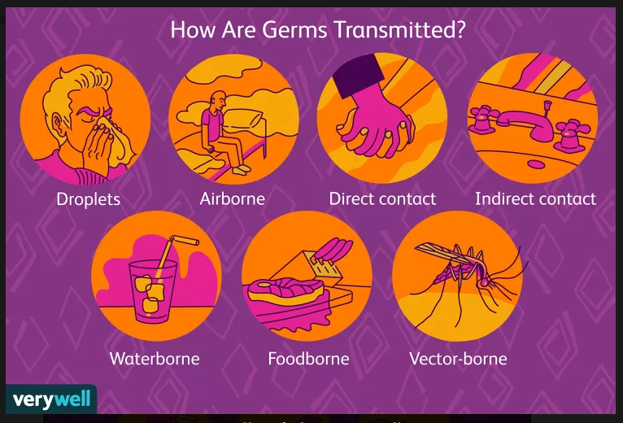
INFECTION CONTROL
BREAKING THE CHAIN OF INFECTION
Good hand hygiene
Sneezing in your elbow with your mask on
Disposing and replenishing mask and placing soiled tissues in trash immediately
Practicing social distancing (6 feet apart)
Using PPE appropriately
Cleaning frequently touched areas & items

Slide 21
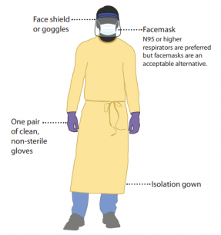
INFECTION CONTROL- Standard Precaution
Previously called Universal Precautions
Assumes blood and body fluid of ANY resident could be infectious
Recommends PPE and other infection control practices to prevent transmission in any healthcare setting
Decisions about PPE use determined by type of clinical interaction with resident

Slide 22
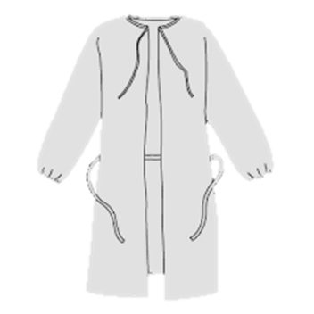


INFECTION CONTROL- Enhanced Barrier Precautions
How do I know when a resident is in Enhanced Barrier Precautions (EBP)?
A resident in EBP will have an identifier on the name plate outside of the resident’s room. Specific instructions will be posted inside of the resident’s room and with the kardex. A list is also kept and updated regularly by nursing staff and the infection preventionist.
When do I wear PPE?
PPE for EBP is not required upon entering the resident’s room. PPE is only necessary when performing the following high-contact resident care activities as listed below:
Dressing
Bathing/showering
Transferring
Providing hygiene
Changing linens
Changing briefs or assisting with toileting
Device care or use: central lines, urinary catheters, feeding tubes, tracheostomy tubes
Wound care: any skin opening requiring a dressing
What PPE do I wear?
GOWN
GLOVES

Slide 23
BLOODBORNE PATHOGENS
POLICY 157 STATEMENT: Exposure to bloodborne pathogens poses a serious risk to healthcare workers. All exposure to blood and body fluids will be reported immediately in order to receive prompt medical evaluation.
If exposed to blood or other potentially infectious materials, the following measures should be taken immediately:
1. For percutaneous injury:
A. Briefly let the wound bleed, then wash area for 10 minutes with soap and water.
2. Nonintact skin exposure:
A. Wash with soap and water for 10 minutes.
3. Mucous membrane exposure:
A. Irrigate copiously with water for 10 minutes.
Contact the Employee Health Nurse/Infection Preventionist or the Nursing Officer of the Day (NOD) after business hours.
An exposure evaluation must be completed immediately.

Slide 24
RESIDENT RIGHTS & RESIDENT IDENTIFICATION
IVH promotes the rights, interests, and well-being of the residents.
Every resident has the right to be free from verbal, sexual, physical, and mental abuse.
Every resident has the right to consideration, respect and dignity.
You are expected to abide by the rights afforded by every resident.
Every resident has the right to be informed of services, charges, rules, regulations. As well as understanding what is being told.
POLICY 209 STATEMENT: The Resident Care Conference team, along with the resident and/or resident representative, will participate in the selection of the type of identification needed for the safety of each individual resident.
A. Elopement Risk: Any resident that is at risk to elope and/or is unable to return to his/her home unit without supervision, will be provided an identification product.
B. Medical Alert: Any resident who requests or the team feels would benefit from wearing an identifier for medical alerts, will be issued a product with the designated information on it.
C. Name Identifier: Any resident who requests or the team feels would benefit from wearing an identifier for their personal identification (i.e. for med passers to identify the resident), will be issued an appropriate product with designated information on it.
D. Resident Room Nameplates: A permanent nameplate bearing the resident’s proper or legal name will be placed outside each resident’s room door.

Slide 25
RESIDENT IDENTIFICATION
Dot Identifier System
Special Considerations: Specific Identification Methods: Colored dots may be placed on individual residents' identification product(s) as an additional precaution.
High Risk for Elopement
Identified by a GREEN dot on their name tag.
If you encounter a resident with a green dot on their name tag, stay with the resident until assistance is provided or the resident is returned to the unit.
Modified Diet
Identified by a RED dot on their name tag.
Indicates that the resident is on a modified diet, has difficulty swallowing or is a choking risk.
Moderate Risk for Elopement
Identified by a YELLOW dot on their name tag.
If you encounter a resident with a yellow dot on name tag and question their safety, stay with the resident until the unit charge person is called to verify the resident’s capabilities.

Slide 26
RESIDENT BOUNDARIES & RISK OF ELOPEMENT
POLICY 235 STATEMENT: The Iowa Veterans Home (IVH) is responsible for the safety, supervision and well-being of all residents. All residents are assessed by the registered nurse for their independence and cognitive abilities with every effort made to promote the highest level of independence while living in the least restrictive environment.
Boundaries for each Nursing level of care resident will be assessed by the RCC team and care planned on the resident’s Kardex under “Locomotion off unit.”
Residents assessed as a moderate or high risk for elopement/breach of boundaries shall be identified as follows:
Residents assessed at a high risk for elopement will be identified by a green-colored dot on their name tag. These residents will be living on a secure or semi-secure unit. Staff who encounter an unescorted resident with a green dot on their name tag will stay with the resident until assistance is provided or the resident is returned to their unit.
Residents assessed at moderate risk of elopement will be identified by a yellow-colored dot on their name tag. Staff who encounter a resident with a yellow dot and question the resident’s safety will call the unit to report concerns and verify resident’s capabilities.
Residents identified at high or moderate risk for elopement will have boundaries and yellow or green dot name tags care planned on their Kardex.
Staff will respond to all exit alarms on the nursing units and account for resident safety as directed.

Slide 27
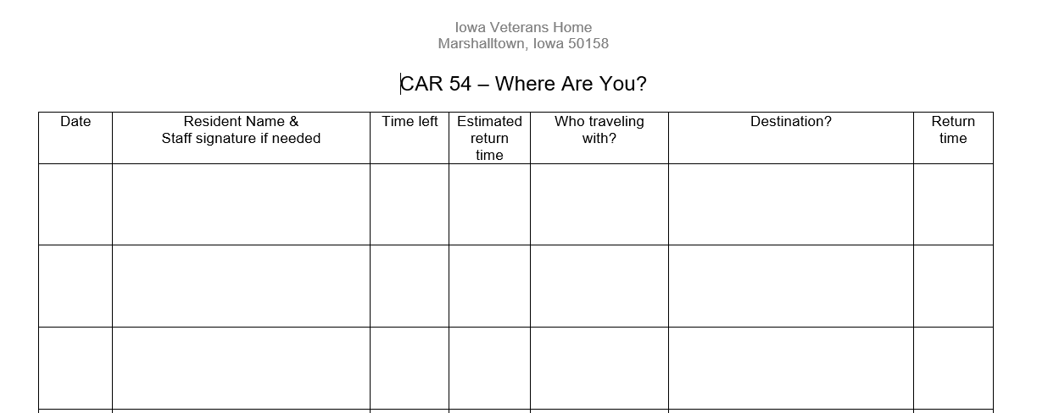
RESIDENT BOUNDARIES- CAR54
Residents who are able to leave unit independently or for an activity with volunteer or with contractor for their medical purpose, may be asked to sign out at the unit and give destination and probable return time.
Utilize the CAR54 book, as listed below.

Slide 28
DEMENTIA
  What is Dementia: Permanent loss of mental abilities caused by damage to brain cells. NOT a “normal” part of aging. Can be the end result of traumas, diseases, infections, and/or drugs/alcohol uses.
Essential Features: Memory Impairment
    Short term memory is affected early
    Long term memory is affected later
      May forget family members’ names
Truths about Dementia:
  Affects multiple parts of the brain
  1/2 of brain tissue may be lost
  All types are progressive. There is nothing that will stop it or reverse it
  All are terminal (5th leading cause of death)
Changes that occur as a result of dementia
Personality Changes
Behavior
Emotion
Communication
The Iowa Veterans Home has residents that live with Dementia on every unit, however, we do have a specialized area for residents that struggle with Dementia.
The Ulery building houses up to 120 residents needing extra memory care assistance, all living with all different severities of Dementia.

Slide 29
RESIDENT SAFETY
Ulery Units 1, 2, 3
Locked doors and a swipe badge is required to enter.
Ulery Units 4, 5, 6, 7, & 8
Unlocked doors with a resident monitoring system in place.
If you are assigned to the Ulery Dementia Building, the following door safety measures must be followed.
Always look through the window to the door to ensure no resident is near the doorway before entering.
After passing through the doorway wait for the door to close and check to ensure the door is latched before walking away.

Slide 30
RESIDENT SAFETY
A Volunteer or Contracted agency, who is providing direct resident care and has not not attained competency in the following safety devices and techniques is required to have the department director provide direct instruction and supervision during the use of these safety devices and techniques:
Wheel Chairs- only safety device for volunteers, as they will never complete further resident care.
Wheel Chairs- push a resident only when wheel chair pedals are attached and being used properly
Transfer Techniques

Slide 31
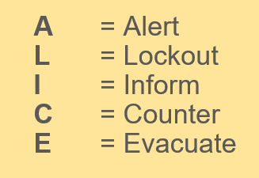

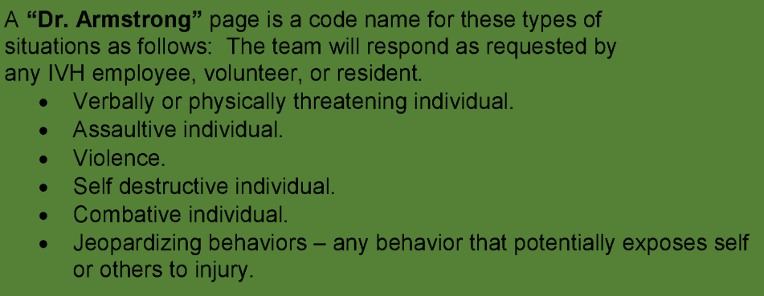
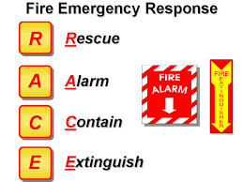
SITUATIONAL AWARENESS
What if you could predict that an event is about to take place and be one step ahead as the event unfolds? Would be nice, wouldn’t it?
Paying attention to our surroundings or “situational awareness” increases your response time to safety handle an unexpected event.
Know what is going on around you!
Emergency/Disaster Plan –Policy 004, click for more information
Emergency????...
Intruder/Lockout response

Slide 32
HAZARDOUS MATERIALS
Each volunteer or contracted agency staff member has the right to know of the existence of any hazardous material in the area in which he/she works.
Safety Data Sheets are electronically stored in the State of Iowa OKTA. Ask a staff member of IVH to assist you to retrieve this information.
Be safety conscious at all times and report any hazardous condition to your liaison for volunteer or contractual services.
Chemical spills will only be handled by IVH personnel using described procedures.

Slide 33
INCIDENTS
Any incident/accident must be reported immediately to the Volunteer Services department or liaison for the contracted services.
If you witness an incident with a resident:
You are expected to stay with him/her with giving medical attention based on your qualifications to do so.
You are expected to cooperate with the investigation process including completing a witness statement if necessary.

Slide 34
EMERGENCY PROCEDURES
In the event of an emergency:
Dial 4333 for help.
Ask IVH employees for assistance.
Refer to the Emergency Procedures Flip book located on all units and departments.
Most Common Emergency Codes
Code Red = Fire
Weather watches and warning. Ask a IVH employee to see what you should do at your current location
Dr. Armstrong = Crisis Response Team
Electrical Safety and Medical Equipment
Any situation that is a potential safety concern, such as a frayed cord, malfunctioning equipment or water on the floor must be reported to an employee or manager who will report it to the appropriate department.

Slide 35
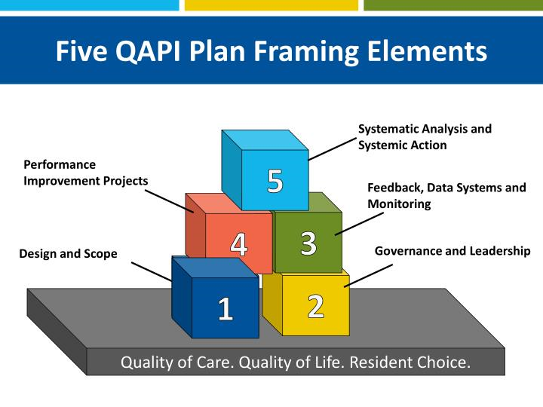
QAPI- WHAT IS IT AND WHY DOES IT MATTER?
QAPI: the coordinated application of two mutually-reinforcing aspects of quality management system:
-Quality Assurance -Performance Improvement
Why QAPI?
Allows us to examine performance and make improvements in areas identified as needing attention
Helps solve quality problems and prevent their recurrence, e.g. Event Reviews
Demonstrates to residents and their families that providing appropriate, quality care is important to the mission of our organization
Good survey results
Improved resident, family and employee satisfaction

Slide 36
COMPLETION OF INITIAL AND ANNUAL CHECKLIST:
STUDENTS and CONTRACTORS
Please CLICK HERE to sign your verification of completion to the Orientation/Contracted Services Module.

