Slide 1
County Training Allocation
By: Nathan Wilson
Operations Executive Administrator
Iowa Department of Veteran Affairs

Slide 2
House File 2663
In addition, from the moneys transferred to the account from the veterans trust fund created in section 35A.13, the department shall annually allocate three thousand dollars to each county commission of veteran affairs, or to each county sharing the services of an executive director or administrator pursuant to chapter 28E, to be used for national training and related expenses of county veteran service officers and appropriate staff.
Notes:
House File 2663 is the bill that allocates the money for the training.

Slide 3
Administrative Rules Chapter 7
COUNTY COMMISSIONS OF VETERAN AFFAIRS FUND AND TRAINING PROGRAM
Notes:
Administrative Rules Chapter 7 is where you will be able to find the process for your county to reimbursed. They are currently working there way through the Administrative Rules process. I have provided the purposed rules in a handout that relate to the County Training Allocation. We had our first public hearing about the purposed rules and no questions or concerns have been expressed with the purposed rules.

Slide 4
County Allocation Process
Review Travel Policy
Go to training
Submit reimbursement form to IDVA within 3o days after training (with required documentation)
IDVA review and process
IDVA sends reimbursement check to County
Note: Remember that IDVA is reimbursing the County not the individual.
Notes:
Remember that IDVA is reimbursing the County not the individual.

Slide 5
County Allocation Process
Reimbursable Expenses
Registration Fee
Airfare/ Plane Ticket
Check bag
Airport Parking
Meals
Transportation-Taxi/ Uber Etc.
Example:
Training is held January 13th thru January 17th of 2025 in Florida.

Slide 6
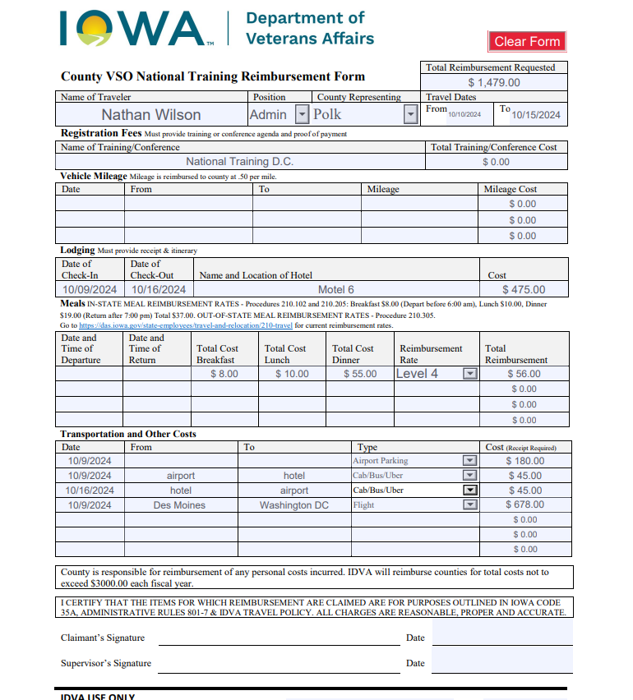
Example of Form
Automatically totals for you.
For questions about the form you can contact Melissa Miller by email @ melissa.miller2@iowa.gov or by phone @ 515-727-3443
Website to see reimbursement rate for city you are visiting.
Notes:
Please pull out the form that was enclosed in the packet of information that was sent out.

Slide 7
Any Questions???
Nathan Wilson
Operation Executive Administrator
Cell: 641-750-6911
Email: nathan.Wilson@ivh.state.ia.us

