Slide 1
VA Central Iowa Health Care System Caregiver Support Program

Slide 2
Overview
Introduction to VA Caregiver Support Program
Program of General Caregiver Support Services (PGCSS)
Program of Comprehensive Assistance for Family Caregivers (PCAFC)

Slide 3
Overview of Caregiver Support Program
Our mission is to promote the health and well-being of family caregivers who care for our nation’s Veterans, through education, resources, and supportive services, and service excellence.
VHA also offers in-home and support services to all Veterans
Home Tele-health
Home-maker and Home Health Aides
Program of General Caregiver Support Services (PGCSS)
Respite Care
Specialty Clinic Care
Training and Education (e.g., Building Better Caregivers)
Caregiver Support Line
Diagnosis Specific Programs for Caregivers
Caregiver Support Program Website
Peer Support Mentoring
Email Listserv
REACH VA
Self-care courses
Home Hospice Care
Adult Day Health Care Centers
Program of Comprehensive Assistance for Family Caregivers (PCAFC)
Financial stipend
Access to CHAMPVA health care insurance (if otherwise uninsured)
Mental health counseling
Caregiver training
Enhanced Respite services
Beneficiary Travel, lodging and subsistence for medical appointments
Ongoing monitoring
Home-Based Primary Care
Skilled Home Care

Slide 4
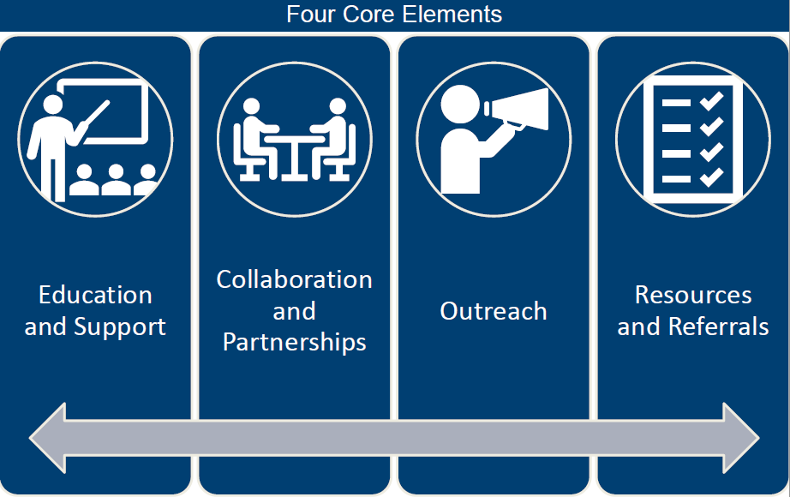
Program of General Caregiver Support Services (PGCSS)
Vision: To serve caregivers with respect and service excellence through a wide range of support, education, and tools that empower them to care for themselves and the Veteran.

Slide 5
National and Local Resources
National Resources:
Annie Caregiver Text Support
Building Better Caregivers
Peer Support Mentoring
Caregiver Support Line
Caregiver Education Calls
Resources for Enhancing All Caregivers Health (REACH) VA
Suicide Prevention Toolkit for Caregivers
Local Resources:
Caregiver Resource Fair
Caregiver Support Summit
REACH (individual and group) sessions
Support Groups and Educational Events
Self-Care Courses
VA SAVE
Mental Health counseling
Notes:
Annie = text messaging service that promotes self-care for CGers
Building Better Caregivers = Provides CGers with training in how to provide diagnosis specific care and how to manage their own emotions, stress, and physical health. 6 week group workshop.
REACH = Resources for Enhancing All Caregivers Health (provides support to stressed and burdened CGers) – specific to diagnosis of Vet or general)
Contact local CSP to sign up/learn more

Slide 6
The Program of General Caregiver Support Service
The Program of General Caregiver Support Services (PGCSS) provides resources, education and support to Caregivers of Veterans.
The Veteran does not need to have a service-connected condition, for which the caregiver is needed, and may have served during any era.
No formal application is required.

Slide 7
National Resource
Annie Caregiver Text Support
Text messaging service that promotes self-care for caregivers.
Provides tips three times per week.
Stress management
Coping During COVID
Dementia Behaviors
Grief Support
Messages may be educational, motivational, or an activity.

Slide 8
National Resource
Building Better Caregivers
Provides caregivers with training in how to provide diagnosis specific care and how to manage their own emotions, stress, and physical health
Six-week online workshop
Serves caregivers of Veterans with memory difficulties, PTSD, a serious brain injury or any other serious injury or illness
Go here to learn more and sign up: https://va.buildingbettercaregivers.org/

Slide 9
National Resource
Peer Support Mentoring
Developed to strengthen relationships between caregivers, provide networking opportunities, and to empower caregivers to help one another
Links caregivers to a peer who has had similar challenges and situations
Mentors can provide personalized guidance, friendship, and a good listener if needed

Slide 10
National Resource
Caregiver Support Line
1-855-260-3274
VA clinical social workers respond to calls from caregivers, Veterans, and community agencies
Provide information about available resources, offer supportive counseling, and connect callers to their local Caregiver Support Coordinator

Slide 11
National Resource
Caregiver Support Line Telephone Education Groups
Offers monthly telephone educational calls for Caregiver
Educational theme is “Care for the Caregiver” with topics changing monthly
Both English (monthly) and Spanish (quarterly) support calls are offered.

Slide 12
National Resources Offered at Local Level
VA S.A.V.E. for Caregivers Training
Virtual training offered twice a year which teaches caregivers how to recognize warning signs for suicide risk and connect veterans in distress to help
Information is given on resources
And overview is given on PGCSS
Time is given for a mindfulness skill for self-care

Slide 13
National Resources Offered at Local Level
Resources for Enhancing All Caregivers Health (REACH) VA
Evidenced based intervention delivered by VA clinical staff, via individual or group sessions.
Provides support to stressed and burdened caregivers
Serves Caregivers of Veterans with dementia, spinal cord injury, MS, PTSD and ALS
Can be delivered by phone, telehealth, or face-to-face

Slide 14
National Resource Offered at Local Level
Caregivers FIRST
Evidence-based program
Caregiver skills group training program with the goal of connecting caregivers with each other and resources to help them feel confident and supported in caregiving role
Topics range from hands-0n and shared decision-making strategies, coping skills, support-seeking skills, and navigating the VA system
Caregivers get a workbook
Virtual and telephone

Slide 15
National Resource Offered at Local Level
Caregiver Health and Wellbeing Coaching
The caregiver and a CSP staff trained in Caregiver Health and Wellbeing Coaching partner to implement a plan to enhance overall physical, emotional, and mental health
The coach will use a guiding helping style which places the focus on the caregiver and caregivers needs
Caregiver Health and Wellbeing Coaching is based on VA’s cutting-edge Whole Health approach, which focuses on what matters to you, not what’s the matter with you

Slide 16
Local Resources
Caregiver Support Group is held in-person and telephone/virtual on the second and fourth Tuesdays of each month. This group is intended for all caregivers. This is an open group, and caregivers can attend as they are able.
PTSD Support Group held virtual/telephone the second and fourth Thursdays of each month from 5:30-6:30 pm. This group is intended for those who care for a veteran with PTSD. This is an open group.

Slide 17
PCAFC
Program of Comprehensive Assistance For Family Caregivers

Slide 18
Program of Comprehensive Assistance for Family Caregivers (PCAFC)
Eligibility
The Veteran must have a serious injury incurred or aggravated within the specified phased expansion date. Serious injury means any service-connected disability that (1) is rated at 70 percent or more by VA, or (2) combined with any other service-connected disability or disabilities, is rated at 70 percent or more by VA.
The Veteran must need in-person personal care services for a minimum of six (6) continuous months based on one or more of the following:
- An inability to perform an activity of daily living. - A need for supervision or protection based on symptoms or residuals of neurological or other impairment or injury; or - A need for regular or extensive instruction or supervision without which the ability of the Veteran to function in daily life, would be seriously impaired.
See Slide Notes
Notes:
Visual representation of VA Mission ACT – provides overview of intent (why we are doing this)
Expands eligibility to all eras
Increases oversight
Standardizes eligibility determinations
Promotes consistency of caregiver training
Provides additional benefits of Legal Services & Financial Planning

Slide 19
Program of Comprehensive Assistance for Family Caregivers (PCAFC)
In addition to all services under the General Program, eligible Caregivers may also receive:
Financial monthly stipend
OPM GS Annual Rate for GS 4, Step 1
Level 2: For an eligible Veteran who is determined to be unable to self-sustain in the community, the Primary Family Caregiver’s stipend amount will be 100% of the monthly stipend rate.
Level 1: For an eligible Veteran who is determined to be unable to self-self sustain in the community, the Primary Family Caregiver’s stipend amount will be 62.5% of the monthly stipend rate.
*Legacy Participants are on a 3-tier system
Counseling/ Virtual Psychotherapy Program for Caregivers (VPPC)
Enhanced Respite care
Legal and financial planning services for Primary Family Caregivers
Access to health care through CHAMPVA, if eligible
Beneficiary travel benefits*
* Please see PCAFC staff for specifics
See Slide Notes
Notes:
Visual representation of VA Mission ACT – provides overview of intent (why we are doing this)
Expands eligibility to all eras
Increases oversight
Standardizes eligibility determinations
Promotes consistency of caregiver training
Provides additional benefits of Legal Services & Financial Planning

Slide 20
PCAFC - What about those already approved?
Legacy Participants:
Veteran and Caregivers enrolled in the PCAFC prior to 10/01/20.
VA Central Office continues to review and examine the Program of Comprehensive Assistance for Family Caregivers (PCAFC) eligibility criteria.
VA will not remove anyone from the program or decrease any support based on reassessments before re-examination of our current eligibility criteria. Changes will be considered if necessary.

Slide 21
How to Apply to PCAFC
Veterans and Caregivers may apply for the PCAFC in three ways:
Complete the application online at: http://www.caregiver.va.gov
For most, this is the fastest and easiest route!
Access and download the application (VA Form 10-10CG) and mail to your local Caregiver Support Program.
You may also contact your local Caregiver Support Program for assistance at 515-699-5477
Connect with your local Veteran Service Office for assistance in completing and submission of the application.
See Slide Notes
Notes:
Visual representation of VA Mission ACT – provides overview of intent (why we are doing this)
Expands eligibility to all eras
Increases oversight
Standardizes eligibility determinations
Promotes consistency of caregiver training
Provides additional benefits of Legal Services & Financial Planning

Slide 22
Recent Changes
There is a new 10-10CG application to apply for PCAFC
Please make sure you put the County the Veteran and Caregiver reside in and not the Country.
All application and decision letters will be mailed to the POA on file for the Veteran.

Slide 23
How Do You Reach Your Local Caregiver Support Program?
VA Central Iowa Caregiver Support Contact Information
Centralized e-mail: CentralIowaCaregiverSupport@va.gov
Centralized phone contact: 515-699-5477
Caregiver Support Program Manager
Michelle Buethe, LISW
515-699-5662
Program Support Assistant
Brenda Bartels
515-699-5477
Program of General Caregiver Supportive Services (PGCSS)
Caregiver Support Coordinator:
Sarah Greazel, LISW
515-661-2864
Program of Comprehensive Assistance for Family Caregivers (PCAFC)
Caregiver Support Coordinator
Sara Simbric, LISW
515-699-5999 x 24015
See Slide Notes
Notes:
Visual representation of VA Mission ACT – provides overview of intent (why we are doing this)
Expands eligibility to all eras
Increases oversight
Standardizes eligibility determinations
Promotes consistency of caregiver training
Provides additional benefits of Legal Services & Financial Planning

