Slide 1
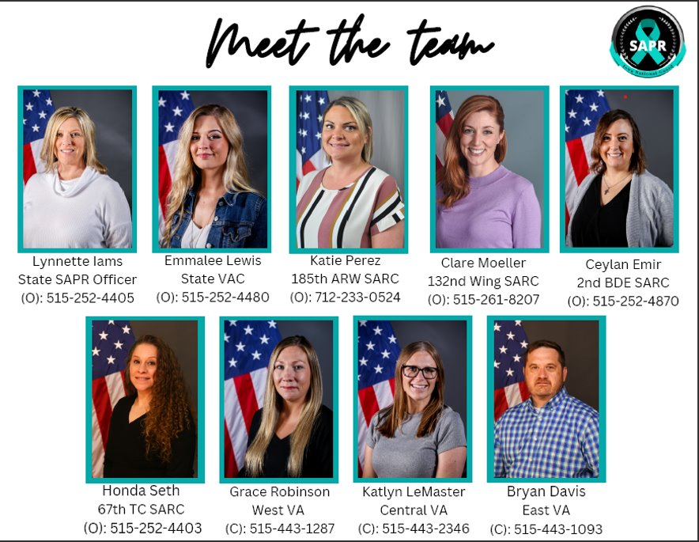
Notes:
-State SAPR Officer
-State Victim Advocate Coordinator
-SARCs at Brigade and Wing commands
-Three geographical victim advocates

