Slide 2
The SBA works to ignite change and spark action so small businesses can start, grow, expand and recover.
Capital
Counseling
Contracting
Advocacy
Disaster
Innovation
www.sba.gov/ia

Slide 3
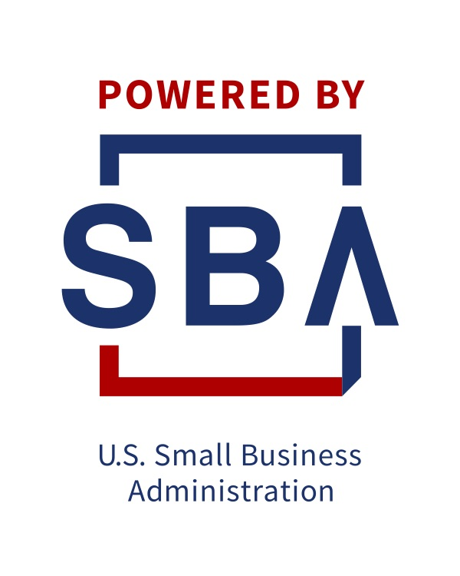
Counseling - The SBA Resource Partner Network
Access the right tools at the right time—wherever you are.
Approved and funded by the SBA
1,400+ partner offices nationwide
Find local resource partners near you at
SBA.gov/local-assistance
Notes:
Talking Points:
When you need reliable advice to start or grow your business, the SBA can connect you with experts who understand the business climate at both a national level, as well as in your specific region or market.
The SBA’s Resource Partner Networks helps to extend our reach to serve the nation’s small business community outside of our District Offices.
Whether you need to create successful business plan, get expert advice on expanding your business, or train your team, the SBA makes sure you’re never far from the help you need.
In FY 2017, over 1.4 million small business owners received counseling or training from an SBA resource partner.
You can find resource partners closest to you using our local partners search page at SBA.gov/local-assistance.
Tips:
Provide a few examples of experts and resource partners in your community in your community.
Distribute or reference the associated Fact Sheet.

Slide 4
Which Resource Partners are Right for You?
If you’re an aspiring entrepreneur or small business owner looking for:
Free business consulting to get started or grow
Low-cost training on crucial topics
Small Business Development Centers
www.iowasbdc.org
Notes:
Tips:
Insert information for the SBDC office that is closest to your audience.
Use this slide if there is only one SBDC office near your audience’s location (see following slide for cases where there are multiple SBDC offices).

Slide 5
Which Resource Partners are Right for You?
If you are an aspiring entrepreneur or small business owner looking for:
Mentorship and advice from volunteer real-world business executives—in-person or virtually
Free online workshops and webinars
SCORE Business Mentors
Go to www.score.org and click “Find a Mentor”
Notes:
Insert information for the SCORE office that is closest to your audience.

Slide 6
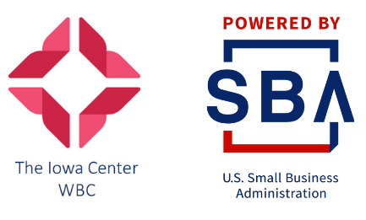
Which Resource Partners are Right for You?
If you are an aspiring or current woman small business owner looking for:
Comprehensive training and counseling on a variety of topics in several languages
Business advice to level the playing field against unique challenges or obstacles
Women’s Business Center
The Iowa Center For Economic Success
2210 Grand Avenue
Des Moines, IA 50312
(515) 283-0940
The Iowa Center Women's Business Center | Iowa Center for Economic Success
Notes:
Tips:
Insert information for the WBC office that is closest to your audience.
Tailor the logo to your region’s office.

Slide 7
Which Resource Partners are Right for You?
If you are a veteran of the US military or a military spouse in need of:
Counseling or transition assistance
Training and advice to start or grow your business, or purchase a new business
Resource referrals
Veteran’s Business Outreach Centers
Nebraska Enterprise Fund
2112 N. 30th St. Suite 103
Omaha, NE
(402) 685-5500
Eswari Kalugasalam
eswarik@nebbiz.org
Notes:
Tips:
Insert information for the VBOC office that is closest to your audience.

Slide 10
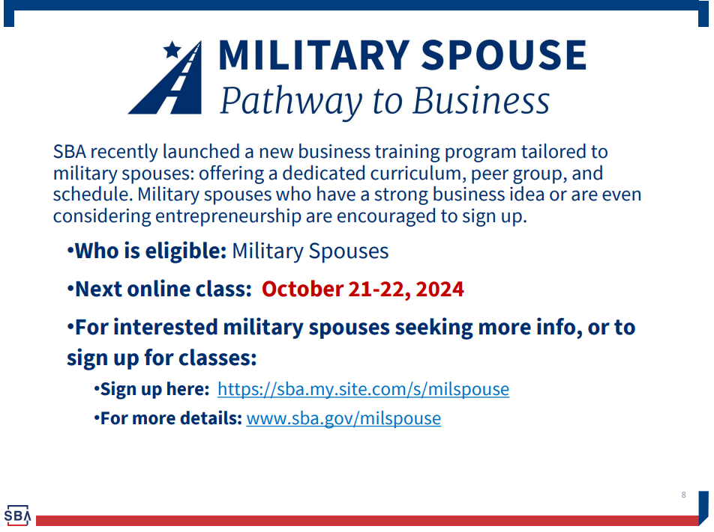

Slide 12
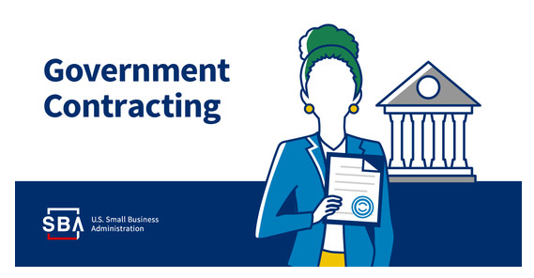
Contracting
8(a) certified
HUBZone certified
Women-Owned
Service-Disabled Veteran
Surety Bonds

Slide 13
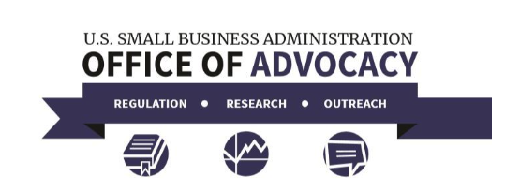
Advocacy
SBA Office of Advocacy
National Ombudsman’s Office

Slide 14
Innovation
Small Business Innovation Research (SBIR)
Small Business Technology Transfer (STTR)
https://www.sbir.gov
Through the Small Business Innovation Research (SBIR) and Small Business Technology Transfer (STTR) programs, America’s Seed Fund awards funding to develop your technology and chart a path toward commercialization. The federal government invests in your solution and gives you the freedom to run your business according to your vision.

Slide 15
Disaster Loan Program
Disaster declaration by President or SBA Administrator
Low interest, long-term loans
Physical Disaster Business Loans
Economic Injury Disaster Loans
Loans for Homeowners, Renters & Personal Property

Slide 16
Need Access to Capital? The SBA Can Help
Notes:
Tips:
Insert your local District Office Twitter handle.

Slide 17
Capital
Loan Programs
7 (a) loans
- 7(a) Standard
- 7(a) Small
- SBA Express
504 loans
New Working Capital Program
Microloans

Slide 18
Why Lenders Consider SBA
Longer Maturity Needed
Lender’s Legal or Policy Limit
Inadequate Collateral
Start Up or Certain Types of Businesses
Other Credit Factors (business/personal history)
Leverage
CRA Credit

Slide 19
Eligibility
Organized for profit
Located in the United States
Be small based on regulatory size requirements
https://www.sba.gov/sites/default/files/files/Size_Standards_Table.pdf
(Alternative Size Standards)
Character
Credit
Repayment Ability

Slide 20
7a Program Basics
Loans up to $5 Million ($3.75 Million SBA exposure)
85 percent guaranty on loans up to $150,000
75 percent guaranty on loans over $150,000

Slide 21
7a Program Basics
Eligible Uses of Proceeds
Working Capital
Inventory Purchase
Revolving Lines of Credit (SBAExpress or CAPLines)
Change of Ownership (Including partial changes of ownership and partner buyouts)
Debt Refinancing (including existing SBA)

Slide 22
7a Program Basics
Eligible Uses of Proceeds
Expansion or Renovation
Construction of new facilities
The purchase of:
Land or buildings
Machinery & Equipment
Furniture and Fixtures
Leasehold Improvements

Slide 23
7a Program Basics
Maximum Maturities
Based on intended use of proceeds
Inventory or Working Capital – 7 to 10 Years
Equipment
Normally 10 years
Up to 25 years with documentation to support useful life
Real Estate – 25 years
Mixed Purpose
Blended based on use of proceeds

Slide 24
7a Program Basics
Maximum Interest Rates
Negotiated between lender and borrower
SBA sets maximum allowable interest rates
May be fixed or variable

Slide 25
7a Program Basics
Maximum Interest Rates
Maximum Variable Rate Over $50,000:
7 year term or longer, 2-3/4% over published rate
less than 7 year term, 2-1/4% over published rate
Maximum Variable Rate $50,000 or Less
Up to $25,000: standard limit + 2%
Over $25,000 to $50,000:
standard limit +1%

Slide 26
7a Program Basics
SBA Fees –ADJUSTMENTS FOR FY 24
Guaranty fee for loans with a term of 12 months or less – 0% for loans of $1 million or less and .25% for loans > $1 million.
Guaranty fee for loans with a term of >12 Months:
0% for $1 million or less.
For loans of $1,000,001 to $2,000,000: 1.45% of the guaranteed portion up to and including $1 million, plus 1.7% of the guaranteed portion over $1 million.
For loans over $2 million up to $5 million, 3.5% on the portion up to $1 million plus 3.75% for the portion over $1 million.
Annual Service Fee – For FY 24 the Annual Service Fee to lenders on 7(a) loans is:
0% for loans of $1 million or less
0.55% for loans over $1 million up to $5 million
Guaranty fee based on guaranteed portion of the loan.
Lender’s Annual Service Fee based on the GROSS loan approval amount (both guaranteed and unguaranteed portions)

Slide 27
The 7a Umbrella
7(a) Standard Loans (over $500,000)
7(a) Small Loans ($500,000 and less)
SBA Express ($500,000 and less)
PLP
Veterans Advantage
CAPLines
New Working Capital Program
Export Express
Export Working Capital Program
International Trade Loans

Slide 28
7(a) Collateral Requirements
Collateral shortfall is typically the primary reason for using SBA
SBA guaranty is not a substitute for available collateral
Personal assets, individually or jointly, may be required to cover any collateral shortfall on loans over $500,000.
If there is at least 25% equity in a personal residence SBA will require a lien when the business assets do not fully secure the loan.

Slide 29
7(a) Collateral Requirements
No collateral required on loans of $50,000 or less
For loans of $500,000 or less, lender follows its own collateral policies and procedures for same sized non-SBA commercial loans. However, at a minimum, lenders must obtain a lien on the borrower’s fixed assets to secure the loan.
For loans in Excess of $500,000 SBA requires Lender to collateralize loans to the maximum extent possible up to the loan amount. If fixed assets do not fully secure the loan, Lender must take available equity in Personal Real Estate of Principals as collateral (this includes investment property).

Slide 30
7(a) Equity Injection Requirements
For loans over $500,000 that are used to finance a change of ownership, SBA requires a 10% equity injection.
For all other 7(a) loans, whether to require an equity injection is left up to the lender.

Slide 31
7(a) Equity Injection Requirements
Introducing the Working Capital Pilot (WCP) Program
The WCP is a new pilot loan program that is available to all SBA lenders as part of the 7(a) Loan Program
As the first new 7(a) program since 2012, WCP has been designed to serve as the SBA’s premier working capital program, engineered to meet the needs of modern small businesses
Offering an annual fee structure modeled after the Export Working Capital Program (EWCP), the SBA guaranty fee is assessed in annual increments, allowing Lenders the ability to tailor the loan to the specific need of their clients
The WCP will provide 75% guaranteed lines of credit up to $5 million that can support both domestic and international transactions
Lenders will be able to use the WCP to issue revolving lines of credit with the flexibility to structure both asset-based and transaction-based facilities
WCP is fully supported by the SBA’s team of Export Finance Managers

Slide 32
SBA Express
Lender must qualify
Standard SBA rules still apply
Up to $500,000 with a 50% guaranty
Limited same institution debt refinancing
Lines of credit
Credit decision up to the lender
Interest rates
$50k or less: Prime + 6.5%
Over $50k: Prime + 4.5%
Lower guaranty fees with the 50% guaranty

Slide 33
SBA Express
Lender’s policies & procedures throughout the process (for the most part)
Easiest and quickest for Lender & Small Business (same day approval in most cases)
Allows for Revolving Lines
Maximum term – 10 years (5 years revolving with a 5 year term out)
Combine with other SBA loans (no more than $500,000 in Express though)

Slide 34
Export Loan Programs
Export Express
Up to $350,000 at 90%
$350,001 at 75%
International Trade
Up to $5 million at 90%
Term loan for PWC, equipment, facilities, land and buildings and debt refinance related to I.T.
Up to 25 years
Available for direct and indirect (i.e. supply chain) export financing
Export Working Capital
Up to $5 million at 90%
Short term 1 year working capital loan

Slide 35
Export Loan Programs
Export Express
Up to $350,000 at 90%
$350,001 at 75%
International Trade
Up to $5 million at 90%
Term loan for PWC, equipment, facilities, land and buildings and debt refinance related to I.T.
Up to 25 years
Available for direct and indirect (i.e. supply chain) export financing
Export Working Capital
Up to $5 million at 90%
Short term 1 year working capital loan

Slide 36
504 Fixed Asset Financing Program
Long-term, fixed rate, subordinate mortgage financing for acquisition and/or renovation of capital assets including land, buildings and equipment.
Up to 25-year term for real estate. Heavy equipment 10 or 20-year term.
Self-amortizing.

Slide 37
504 Types of Projects
Hotels and motels
Restaurants
Grocery stores
Service stations/ convenience stores
Dentist’s and doctor’s offices or clinics
Child care facilities
Factories
Auto repair facilities
Auto dealerships (but not the vehicles)

Slide 38
504 CDC
A Certified Development Company (CDC) is a non-profit corporation certified and regulated by the U.S. Small Business Administration to package, process, close, and service 504 loans.

Slide 39
504 Structures
Typical 50-40-10 (maximum)
New Business 50-35-15
Special Purpose building 50-35-15
New business & special purpose building 50-30-20
New business includes not only new business but change of ownership as well.

Slide 40
504 Eligibility
Tangible net worth < $15 million
Average after federal income tax net income of < $5.0 million for the preceding two years
Job creation/retention requirement limiting amount of loan – 1 job created/retained per; $65,000 for regular loans; $75,000 for public policy loans; $100,000 for manufacturing loans.
As an alternative can use 7(a) size standards to qualify

Slide 41
Typical 504 Uses of Proceeds
Buy land and improvements (existing buildings, grading, street improvements, utilities, parking lots, landscaping). OC must occupy 51% of building.
Build new facilities; OC must occupy 60% with plans to occupy 80% within 3 years
Remodel, renovate, or convert existing facilities
Buy long-term machinery and equipment (with 10 year life)
Professional fees, title insurance, appraisals, soft costs
Repayment of interim-loan points, fees, interest
Contingency reserve up to 10% of construction costs
Community improvements up to 5% of construction costs

Slide 42
Ineligible Proceeds for 504
Working capital
Counseling fees
Incorporation or organizing costs
Franchise fees
Advertising
Cars, trucks, airplanes
Equipment or furnishings with less than 10 year life
Broker fees, origination fees
Legal fees

Slide 43
504 Advantages for Borrower
Fixed interest rate even on second mortgage
Long term financing
May have low down payment
Collateral normally limited to project assets
Existing collateral still available for working capital loans

Slide 44
SBA Microloans
Loans up to $50,000 for typical business needs
Lower credit scores accepted
Loan comes direct from SBA via an SBA Microlender
Limited to $50,000 or less
Limited to working capital and fixed-assets
Iowa Microloan
www.iowamicroloan.org
Iowa Center for Economic Success https://theiowacenter.org/services/loans/microloan-eligibility/
Microloan program can assist someone who might become a more “bankable” customer in the future.

Slide 45
SBA Approval Data
FY | Total Loans | 7a | 504
2022 | 466 for $242.6 Million | 347 for $142.8 Million | 109 for $99.7 Million
2023 | 340 for $139.3 Million | 296 for $99.1 Million | 44 for $40.2 Million
2024* | 476 for $193.9 Million | 421 for $146 Million | 55 for $49.9 Million
Veterans Loans
FY 23 13 for $3.5 Million
FY 24 28 for $5.6 Million

Slide 46
QUESTIONS???
Jayne.Armstrong@sba.gov
(515) 284-4026 (direct)
(515) 284-4422 (general office)
www.sba.gov/ia
dmdo@sba.gov

