Slide 1
Veterans Designation on License
Denise Said, Business Systems Administrator
3/2/2023
Name
Title
Date

Slide 2
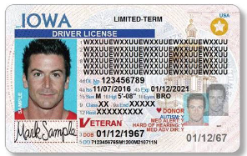
Veteran Link on DOT Web Site
https://iowadot.gov/mvd/military-veteran-services
Take a copy of your DD-214 Copy 4 (certificate of Release or Discharge from Active Duty From the Department of Defense) directly to a Driver’s license issuance location
Ask your county Veterans Affairs office to complete the required Iowa DOT Application form 432035, and then bring it to the Driver’s License issuance location.

Slide 3
Iowa Code 321.189(8) reads:
Veterans status. A licensee who is an honorably discharged veteran of the armed forces of the United States may request that the license be marked to reflect the licensee’s veteran status. Upon such a request, the word “VETERAN” shall be marked prominently on the face of the license. Such a license shall be issued upon receipt of satisfactory proof of veteran status pursuant to procedures established by the department in consultation with the department of veterans affairs, or upon presentation of the licensee’s certification of release or discharge from active duty, DD form 214, to the department at the time of the licensee’s request, if the form indicates the licensee was honorably discharged. If the license is issued upon presentation of the licensee’s certification of release or discharge from active duty, DD form 214, the department shall notify the commission of veteran affairs of the county of the licensee’s residence that the licensee was issued a license marked to reflect the licensee’s veteran status. After receiving notification from the department, the commission of veteran affairs shall initiate contact with the licensee.
Iowa Code
Partnership between Iowa DOT and Commission of Veteran Affairs

Slide 4
County VA Staff can access a list of customers that have been used the Veteran Designation using a DD-214, by specific service area.
4,534 Veterans received the designation in FY24 (July 1, 2023, thru June 30, 2024).
5,430 used the form from your offices.
Benefit of having access is two-fold:
This allows Counties to review the list for the accuracy of adding the designation.
Allows the Counties to contact the Veteran to review benefits allotted to the Veteran.
Veteran Report
Why would I want it?

Slide 5
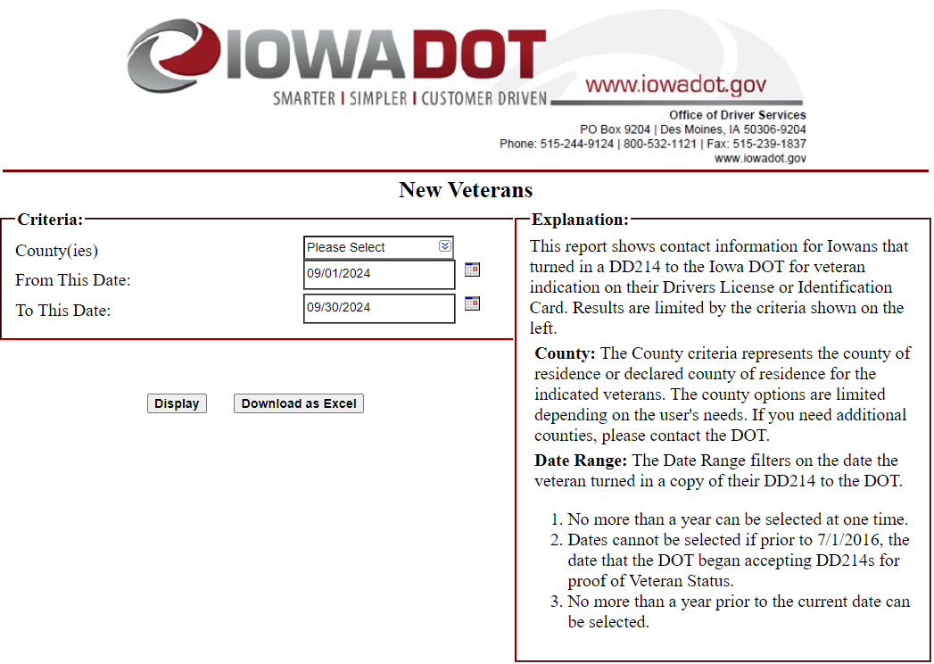
Veteran Report
What does it look like?

Slide 6
Complete Form 431069 – Privacy Agreement. See the Instructions for assistance on filling it out.
Make a photocopy of your License and attach it to the agreement.
Provide Proof of Authority, which is proof you are authorized to make these decision on behalf of the County VA office.
You can Email it to our Privacy Agreements Team at privacy.agreements@iowadot.us, Fax 515-817-6536 or mail it to the Iowa DOT.
Systems & Admin Bureau
PO Box 9204
Des Moines, IA 50306-9204
Veteran Report
How do I get access to it?

Slide 7
Questions?
DENISE SAID
Denise.Said@iowadot.us
PRIVACY TEAM
Privacy.Agreements@iowadot.us

