Slide 1
Connected Care
Heidi A. Vokes, PSA, VACIHCS
Office-515-274-7246

Slide 2
Agenda
Introduction
Upcoming Changes
Login.gov + Id.me
MHV Coordinators nearest you
Virtual Mobile Clinic – Central Iowa
Questions?

Slide 3
What’s Changing?
My HealtheVet
VA.gov

Slide 4
Don’t worry. My HealtheVet isn’t going away.
As of January 31, 2025, you will no longer be able to sign-in to My HealtheVet using your My HealtheVet user ID and password.
2 options (Login.gov and ID.me). As cybersecurity risks continue to evolve, we must improve how your personal and health data is protected by increasing account security.
Accessible through VA.gov

Slide 5
VA.gov
My HealtheVet’s new home
Apply for benefits
Check your claim status
Update your address and other contact information across several VA benefits and services
Check the status of and request help with any benefit overpayments or copay bills you may have
File travel claims and check the status of current claims

Slide 6
How do I create a Login.gov account?
You can create your account on the Login.gov website. Here’s what you’ll need:
An email address
A unique password that includes at least 12 characters
When you set up your account, you’ll need to set up multifactor authentication (MFA).
The first time you use your account to manage your VA benefits or information, you’ll need to verify your identity. Here’s what you’ll need:
Your driver’s license or other state-issued ID, and
Your Social Security number, and
A U.S. phone number
Note: If you don’t have a U.S. phone number, Login.gov can send a letter to your mailing address instead.

Slide 7
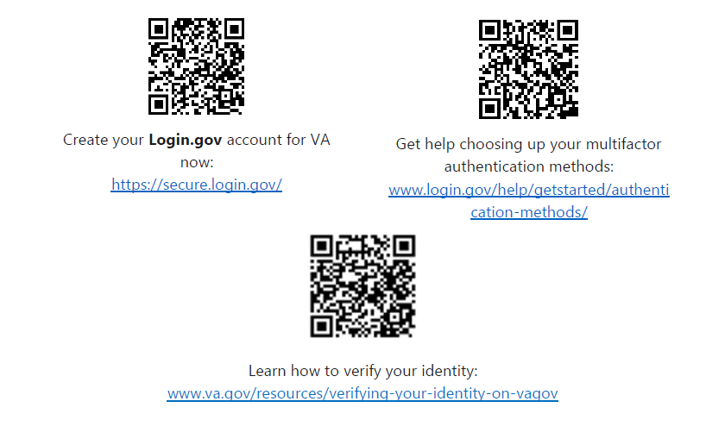

Slide 8
How do I create an ID.me account?
You can create your account on the ID.me website. Here’s what you’ll need:
An email address
A unique password that includes at least 8 characters (with at least 1 uppercase letter, 1 lowercase letter, and 1 number)
When you set up your account, you’ll need to set up multifactor authentication.
The first time you use your account to manage your VA benefits or information, you’ll need to verify your identity. Here’s what you’ll need:
A phone number, and
Your driver’s license, state-issued ID, passport, or passport card

Slide 9
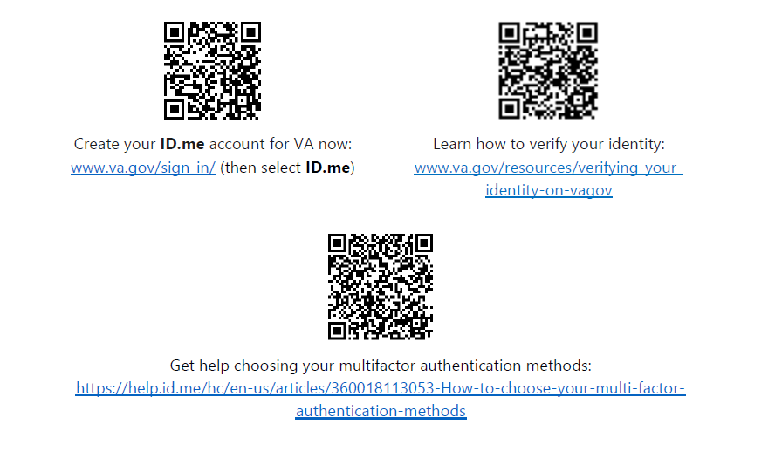

Slide 10
How do I get help?

Slide 11
Connected Care Point of Contacts
Heidi Vokes – Des Moines VA Heidi.vokes@va.gov
Michael Tullis – Iowa City VA Michael.Tullis@va.gov
Lara Carson – Minneapolis, MN VA Lara.Carson@va.gov
Brittany Dibanda – Omaha, NE VA brittany.dibanda1@va.gov
Bert Werning – Sioux Falls, SD VA Bret.Werning1@va.gov

Slide 12
VA Central Iowa Virtual Mobile Clinic
Dedicated to providing the best health care to Veterans living in our rural coverage areas.
Services are provided to veterans currently enrolled within VACIHCS by providers at the main facility in Des Moines, and outpatient clinics in Des Moines, Mason City, Carroll, Marshalltown, Fort Dodge, and Knoxville
The VMC is also part of the VACIHCS outreach program and available to provide support during certain events by approved requests.

Slide 13
Current VMC county availability and services provided
Primary Care
Mental Health
Occupational/Physical Therapy
Speech Therapy
Respiratory Therapy
Dermatology
Battlefield Acupuncture
Labs
Urology
Podiatry Nail Care
Home Telehealth
My HealtheVet Enrollment/Assistance
Social Work

Slide 14
VMC Questions -
Megan Reis – megan.reis@va.gov
Emily Morgan – Emily.morgan@va.gov
Traci Hala – traci.hala@va.gov

Slide 15
Any Questions?

